Slide 1
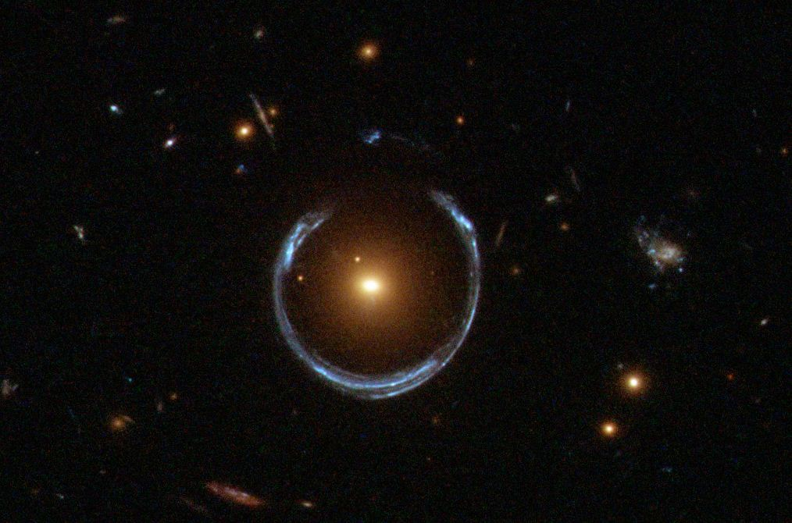
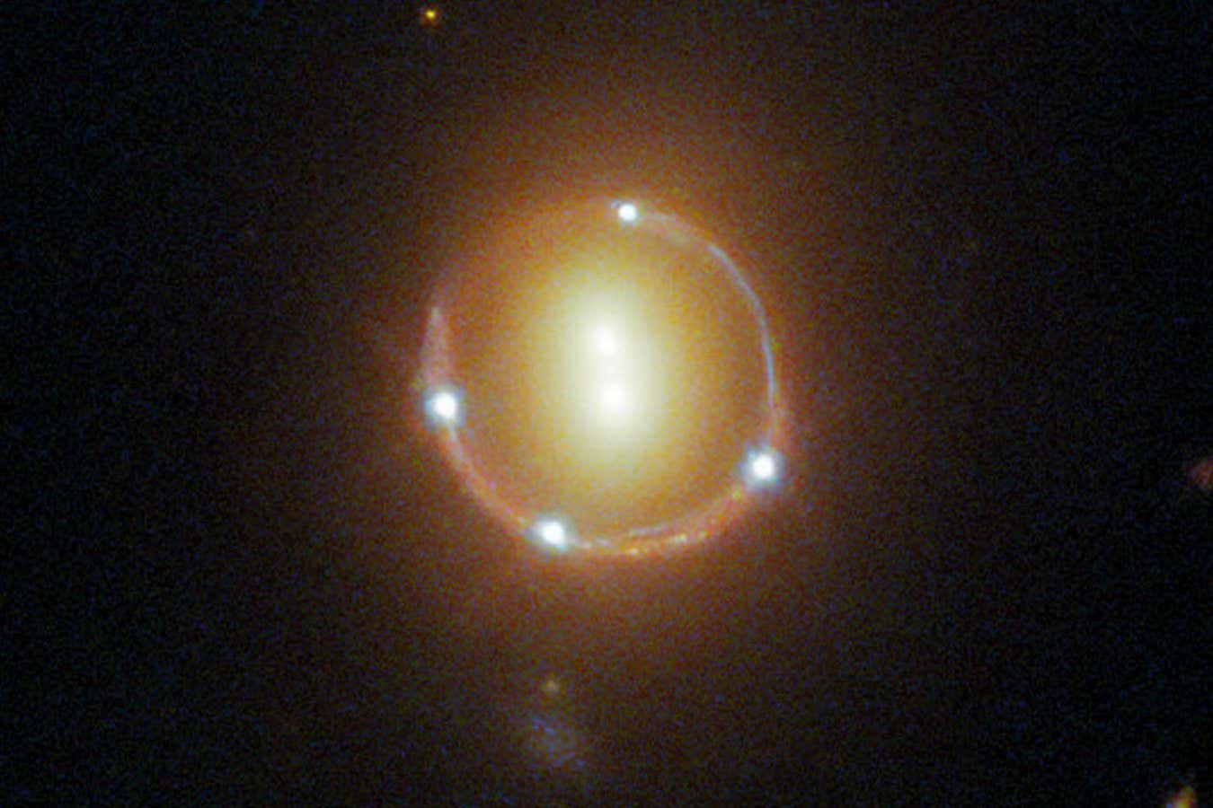
Gravitational Lens Modelling of an IllustrisTNG Mock Multiply Lensed Supernova and the Effect of Cosmic Shear on Model Anomalies
ESA/Hubble & NASA
Rommulus Francis Lewis
Final Year Project
Supervisor: Prof Jeremy Lim
NASA/ESA/STSci

Slide 2
Contents
Introduction
Research Questions
Data and Methodology
Results
Importance
Conclusion
Future Work

Slide 3
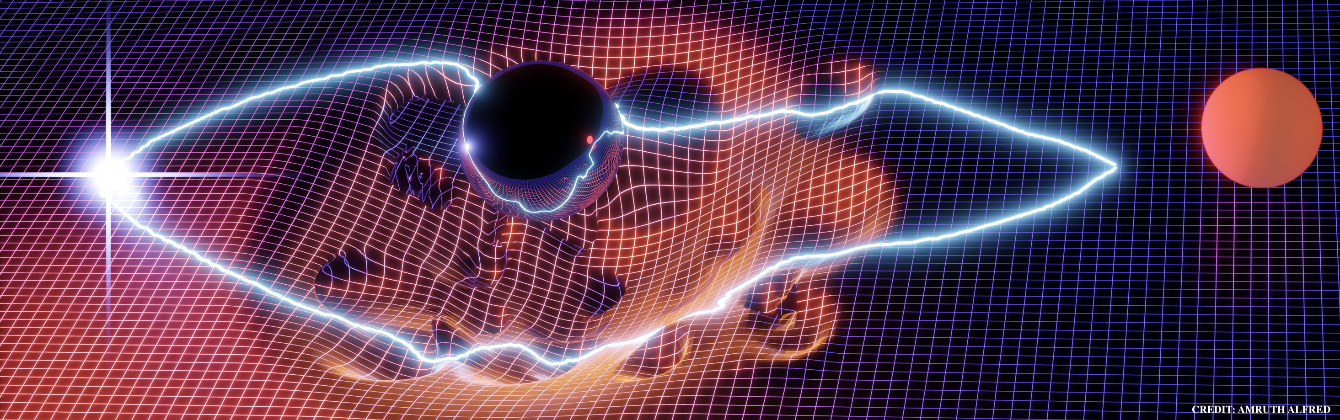
Gravitational Lensing

Slide 4
Strong Gravitational Lenses (Real Data)
Strong Lensing: Multiple images of the same object
4
1
3
2
Einstein Ring
NASA/ESA/STSci

Slide 5
Strong Gravitational Lenses (Real Data)
Lens Modelling
Objective:
Estimate the mass profile
of the lensing galaxy
Image Properties:
Position
Magnification
Lensing Galaxy
Lensed Image
NASA/ESA/STSci

Slide 6
Strong Gravitational Lenses (Real Data)
Lens Modelling
Objective:
Estimate the mass profile
of the lensing galaxy
Image Properties:
Position
Magnification
MATTER
ORDINARY/BARYONIC MATTER
DARK MATTER
Protons
Neutrons
Electrons
?

Slide 7
Strong Gravitational Lenses (Real Data)
Lens Modelling
Model Diagnostics:
Position
Magnification
Current Deficiencies:
Position Anomalies
Magnification Anomalies
NASA/ESA/STSci
Dark Matter Substructure

Slide 8
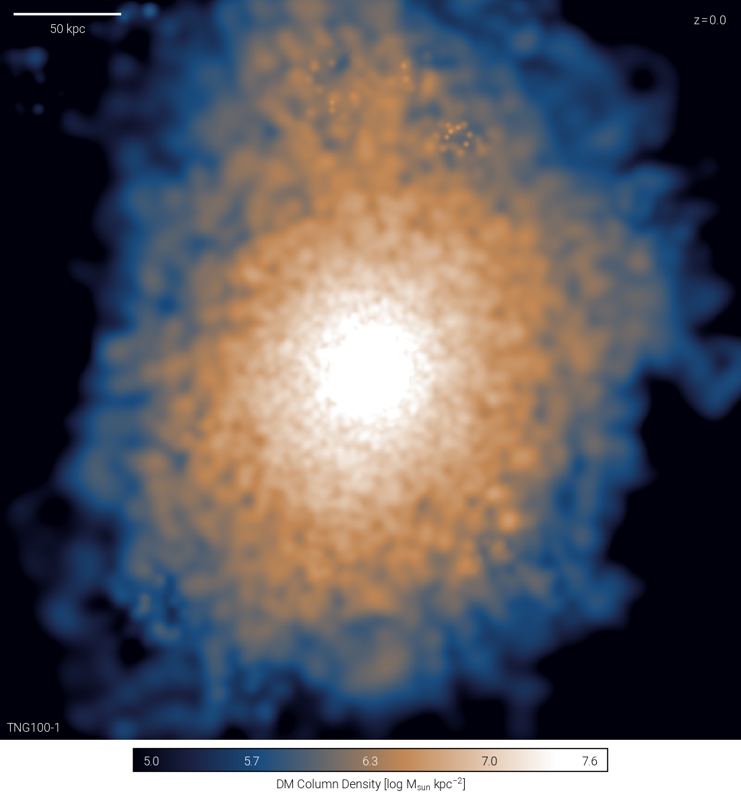
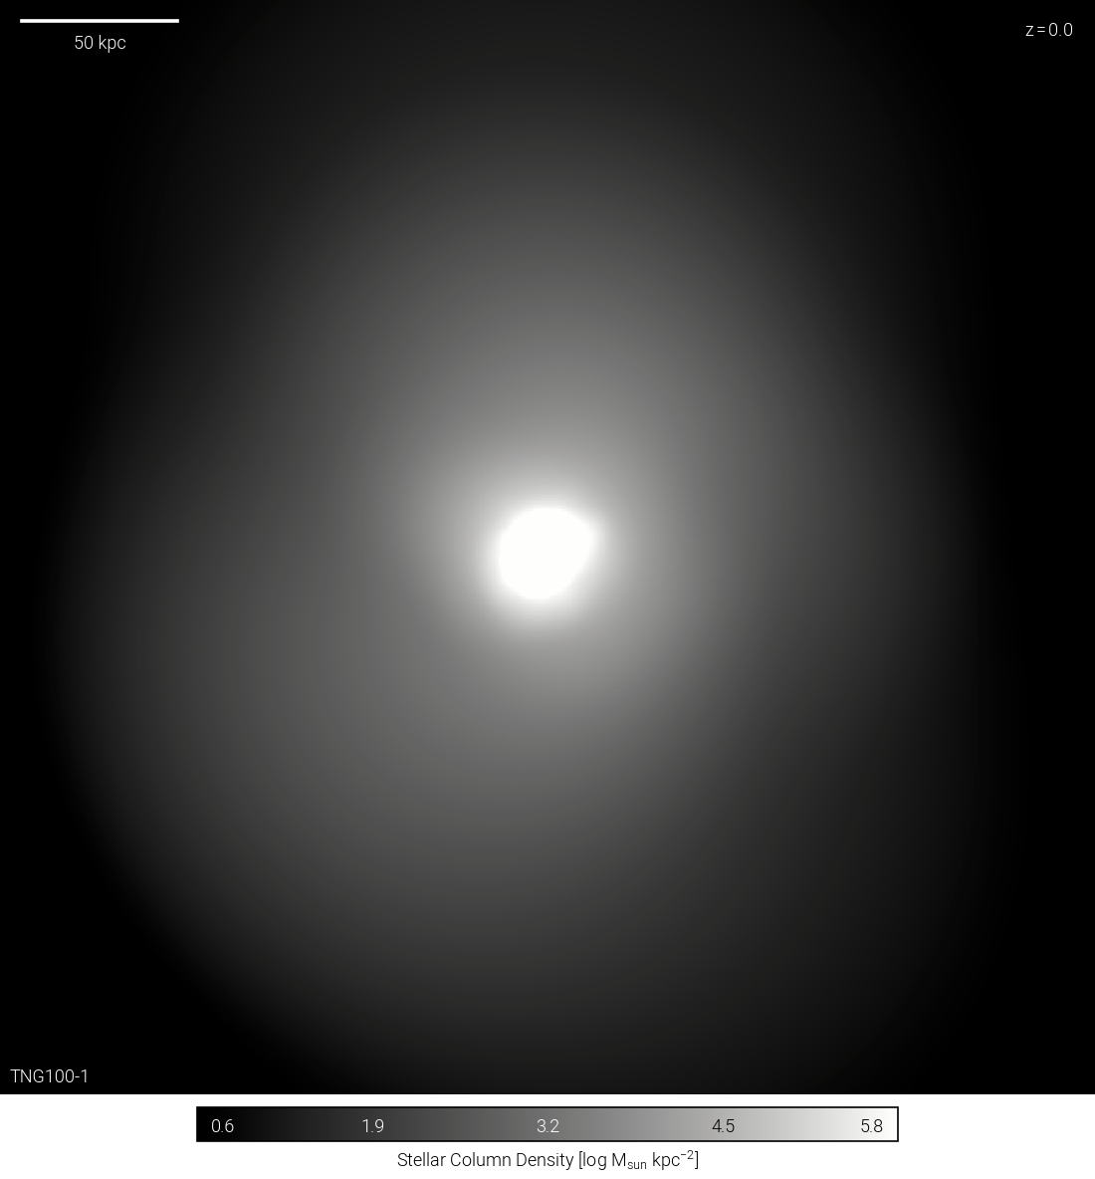
Dark Matter Substructure
Wave-like Dark Matter
Particle Dark Matter
Substructure
Smooth Mass Models do not model substructure

Slide 9
Research Question
1. How accurate are smooth mass models and do they inherently leave position and magnification anomalies? What are the magnitude of these anomalies?

Slide 10
Cosmic Shear
Shear: Mass along the line of sight or from neighboring deflectors
In real lenses adding cosmic shear resolves position and magnification anomalies

Slide 11
Research Question
How accurate are smooth mass models and do they inherently leave position and magnification anomalies? What are the magnitude of these anomalies?
How does adding a shear component affect model anomalies?

Slide 12
Data - Simulations
Getting the data:
Use a simulated galaxy from IllustrisTNG suite of simulations
Place a Supernova behind the galaxy
Get the lensed images
Done by Alex Chow
(MPhil at HKU)

Slide 13
Data - Simulations
Getting the data:
Use a simulated galaxy from IllustrisTNG suite of simulations
Place a Supernova behind the galaxy
Get the lensed images
Done by Alex Chow
(MPhil at HKU)
What we do:
Model the dark matter
Model the baryonic matter
Model other components (SHEAR)

Slide 14
Why Simulations
Lens Modelling
Objective:
Estimate the mass profile
of the lensing galaxy
In Real Data: Mass profile unknown
In Simulations: Mass profile is known
Lensing Galaxy
Lensed Image

Slide 15
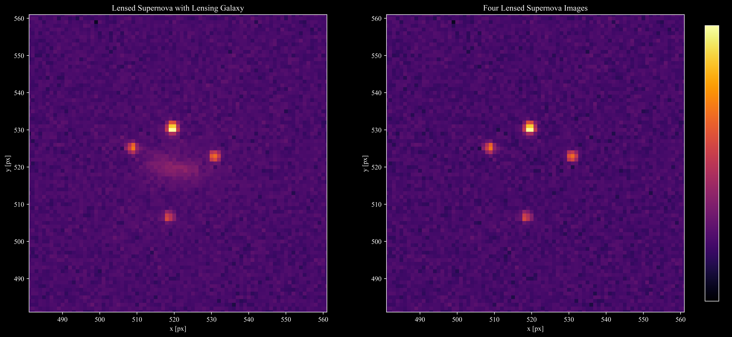
Data

Slide 16
Lens Modelling
Constraints:
Positions
Magnifications
Mass Profiles:
Single Isothermal Ellipsoidal (SIE)
Power Law (POW)
Navarro Frenk White (NFW)
Einasto (EIN)
Cored Single Isothermal Ellipsoidal (CSIE)

Slide 17
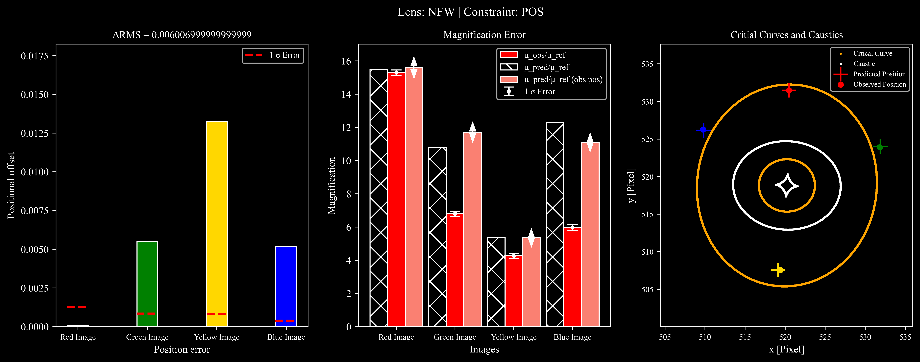
Lens Models

Slide 18
Lens Models

Slide 19
Lens Models

Slide 20
Lens Models

Slide 21
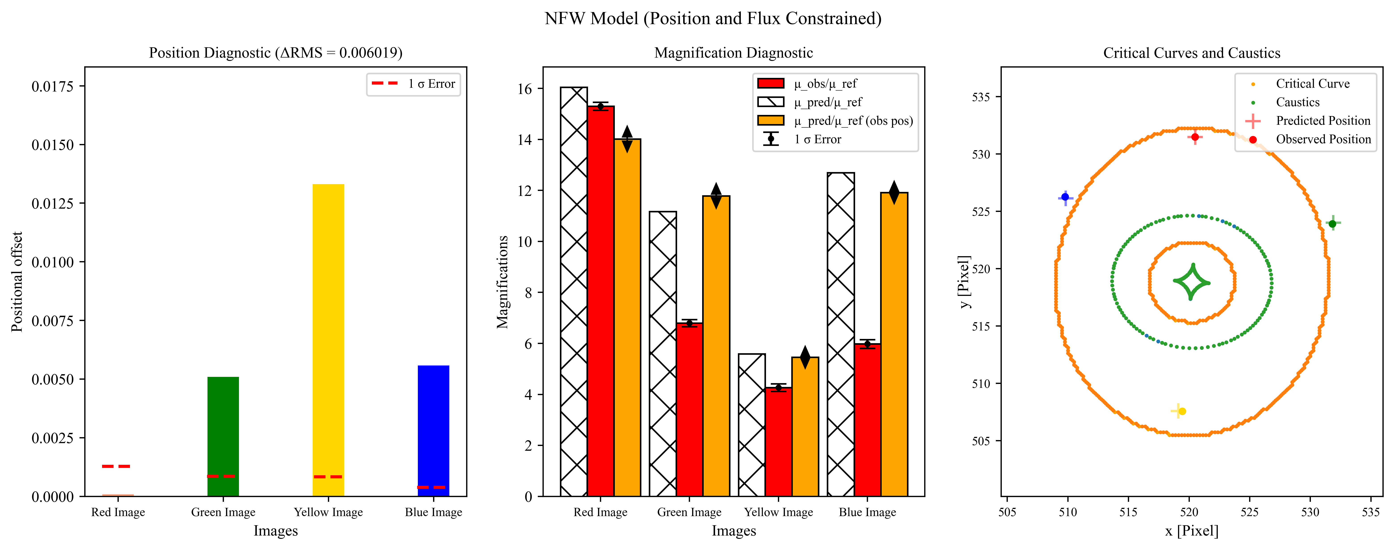
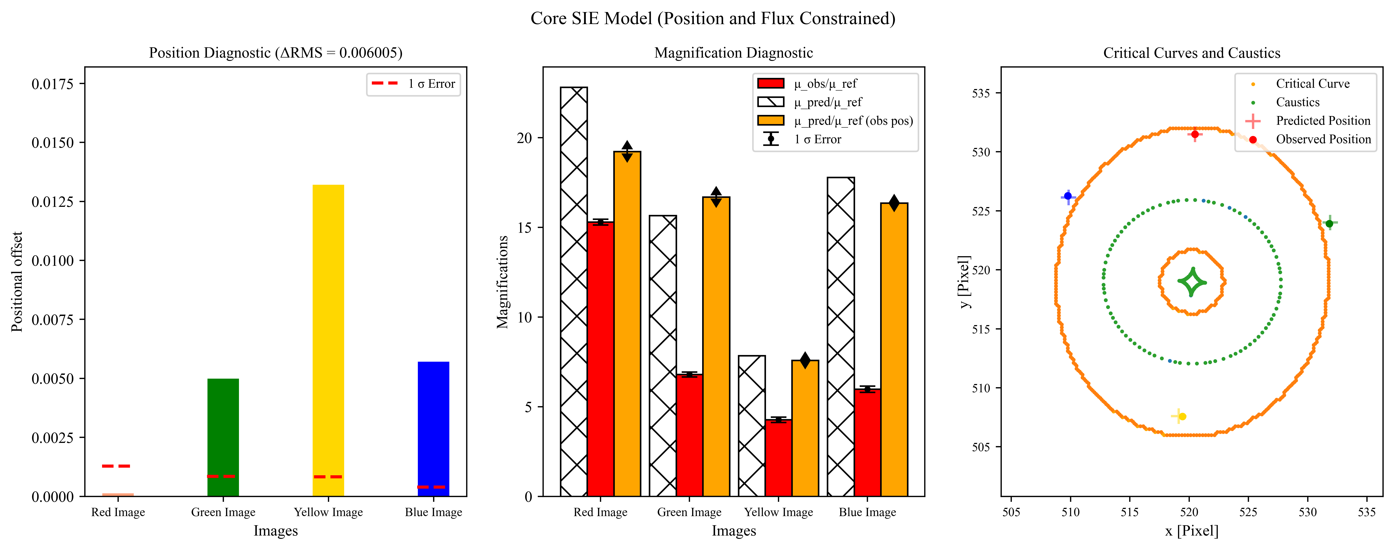
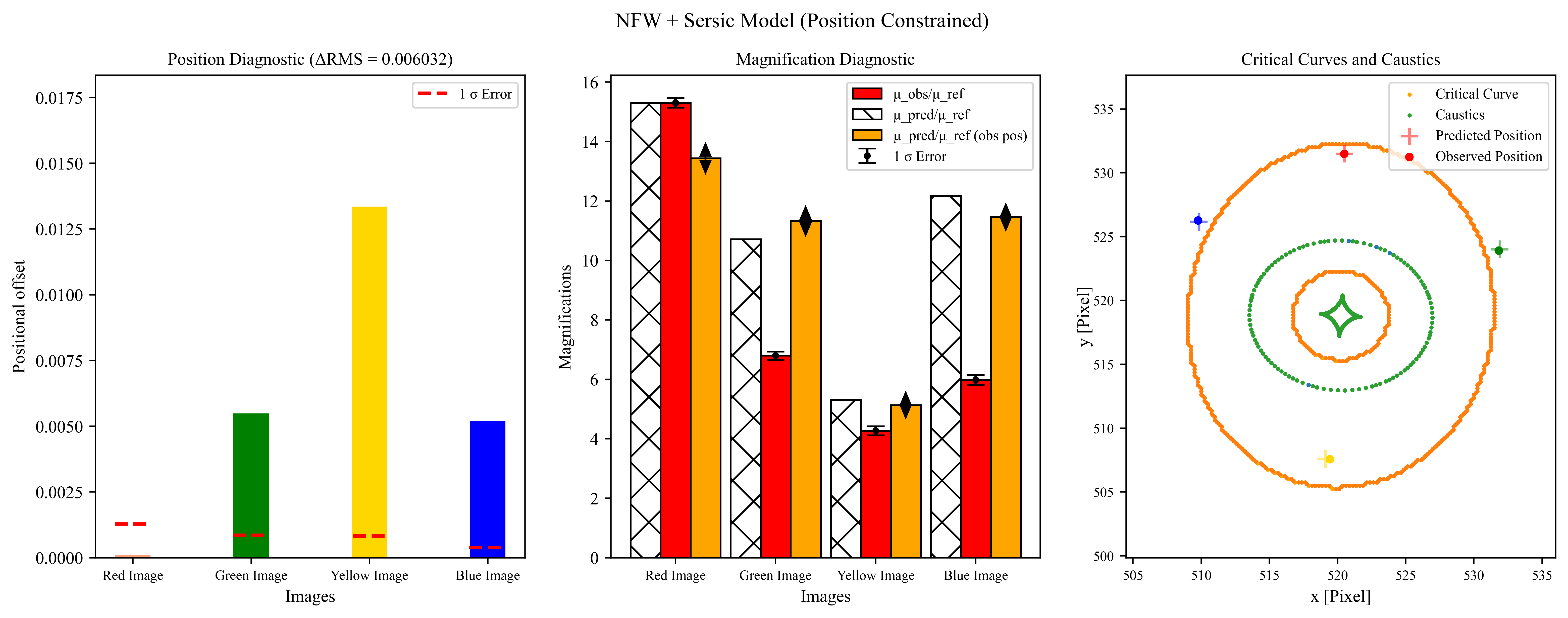
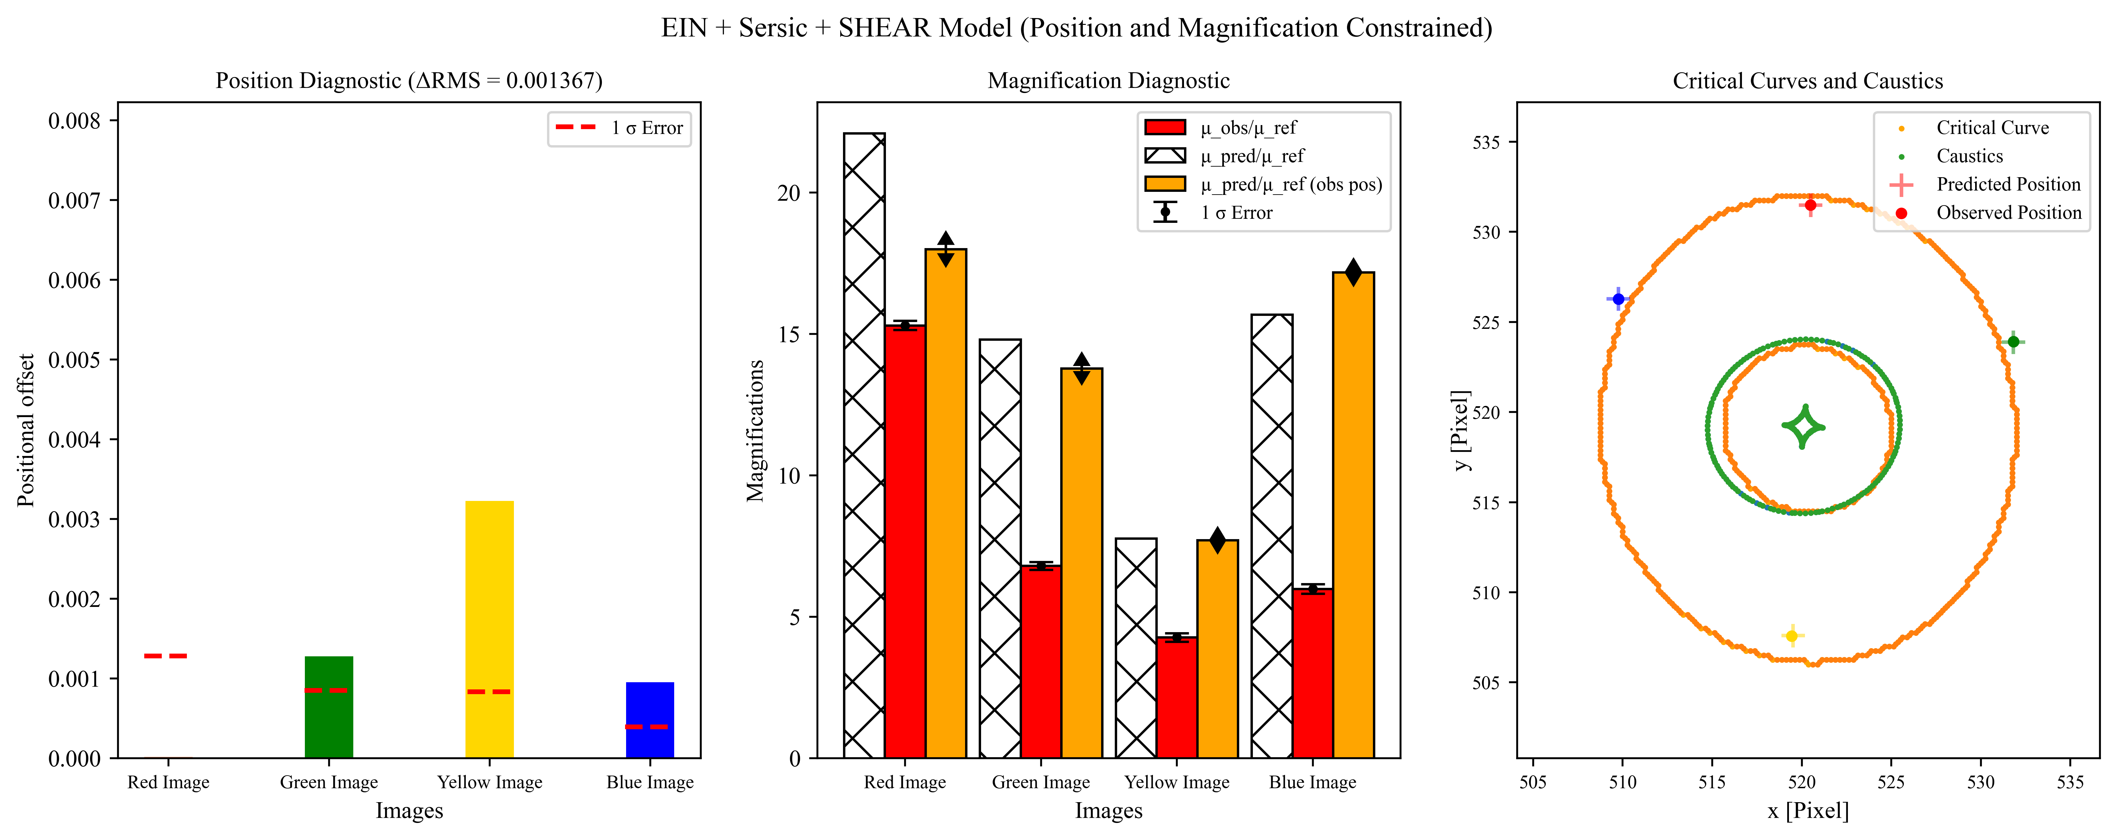
Lens Models

Slide 22
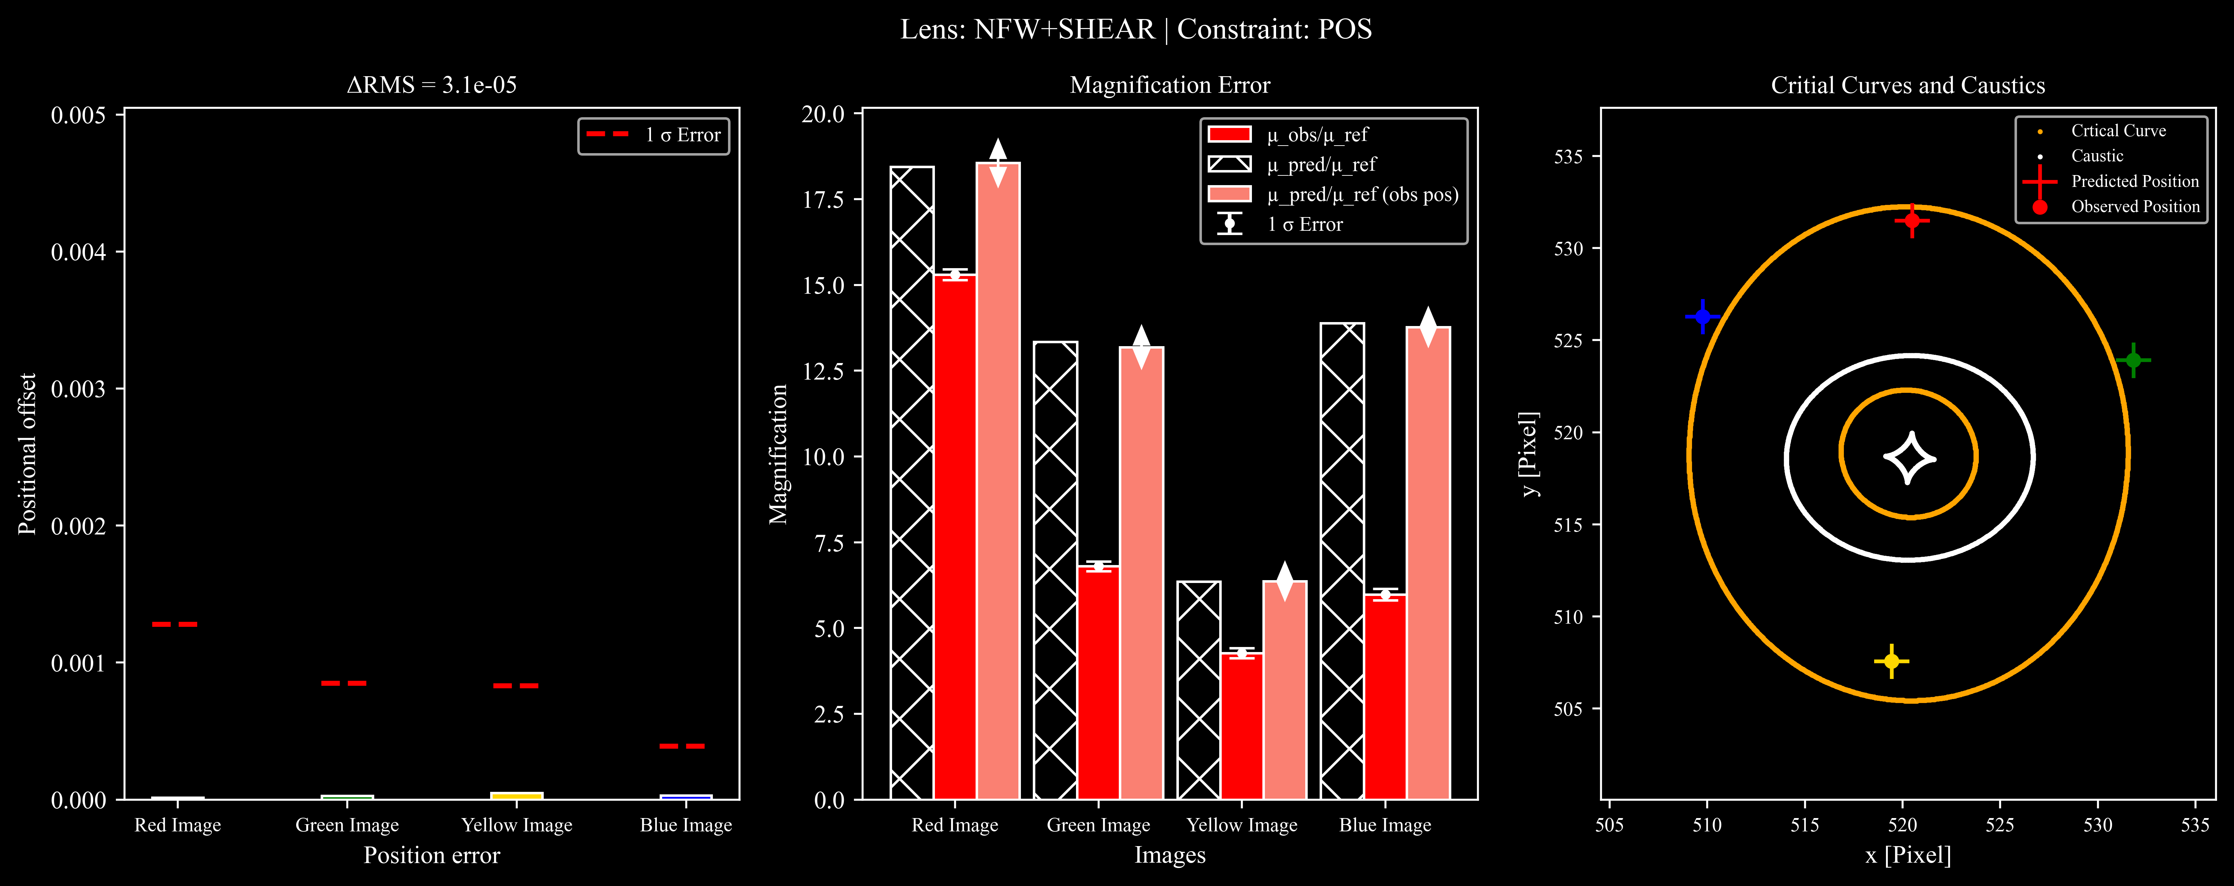
Cosmic Shear

Slide 23
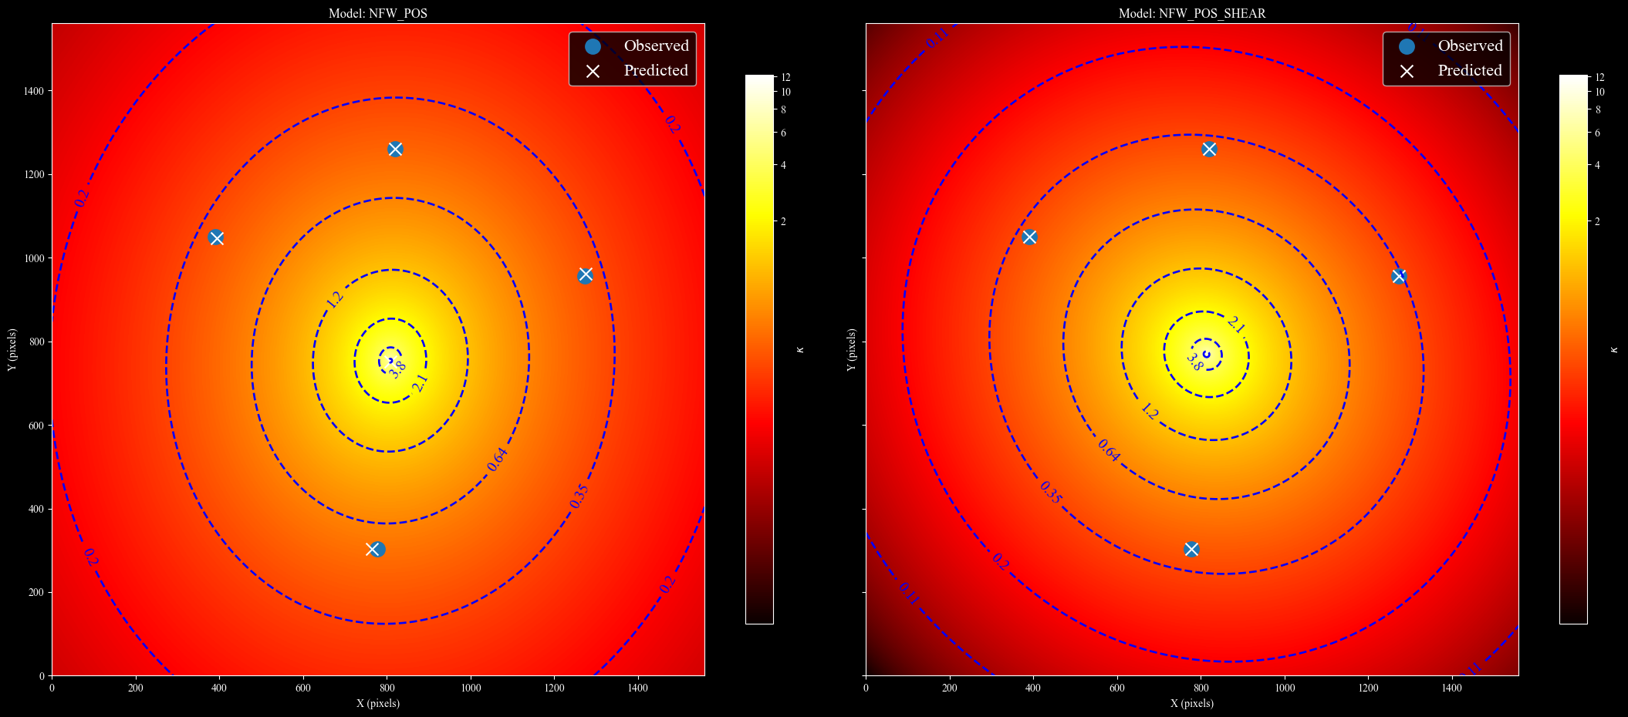
Cosmic Shear

Slide 24
Cosmic Shear

Slide 25
Cosmic Shear

Slide 26
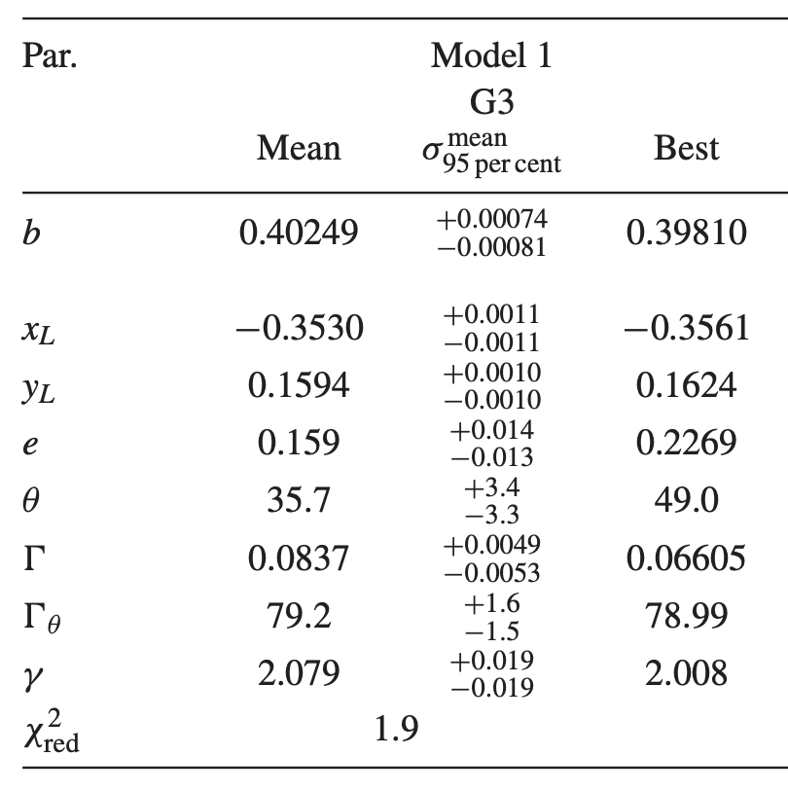
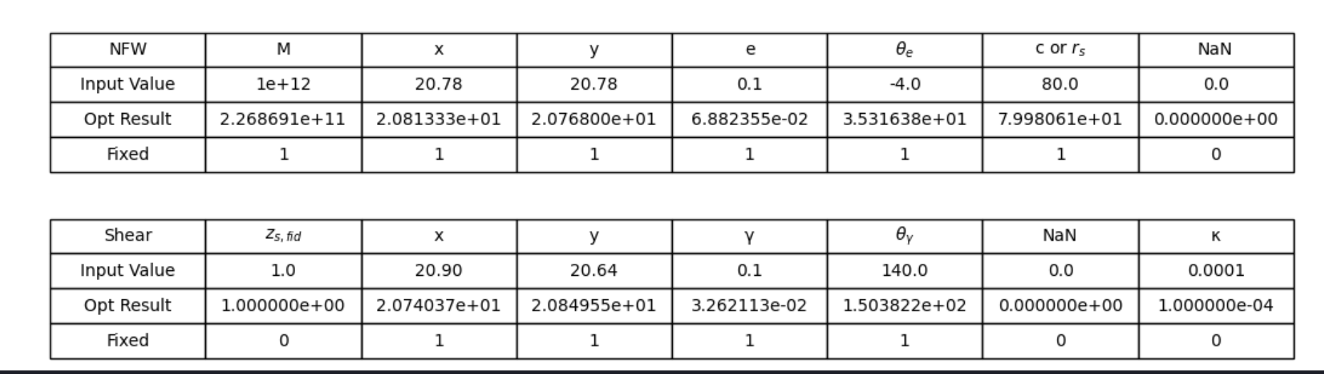
Cosmic Shear
Shear on the same order of magnitude
=
Unphysical

Slide 27
Results
2 Main Results:
None of the > 50 lens models can reproduce the positions and magnifications of all 4 images within 1 σ
Adding a shear component resolves all position anomalies but is unphysical
Interpretation
The smooth mass models we use are inaccurate and do not capture the complexity of the mass profile of the galaxy even without substructure
We need a new approach to account for cosmic shear (4th Order Multipoles)

Slide 28
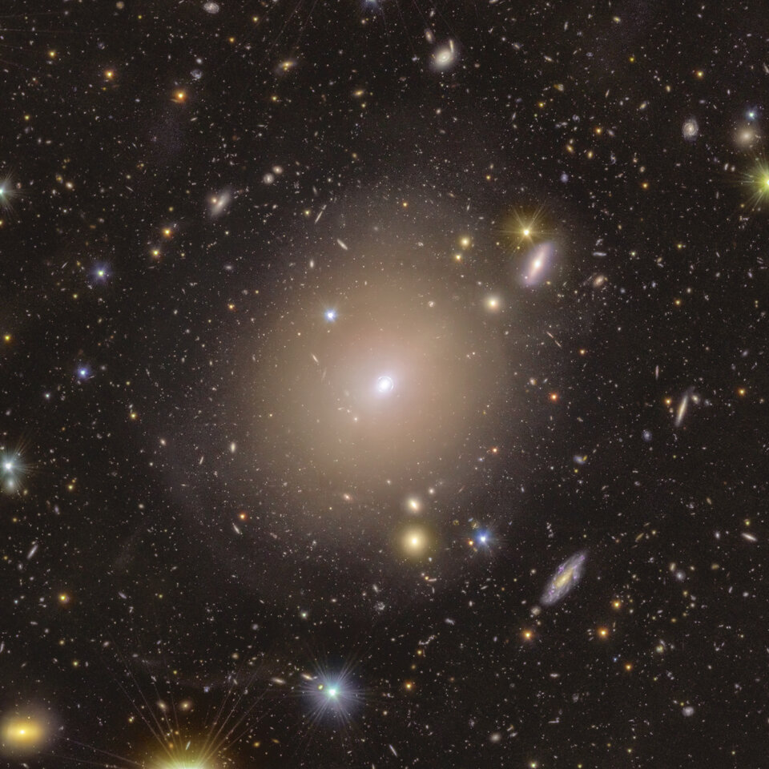
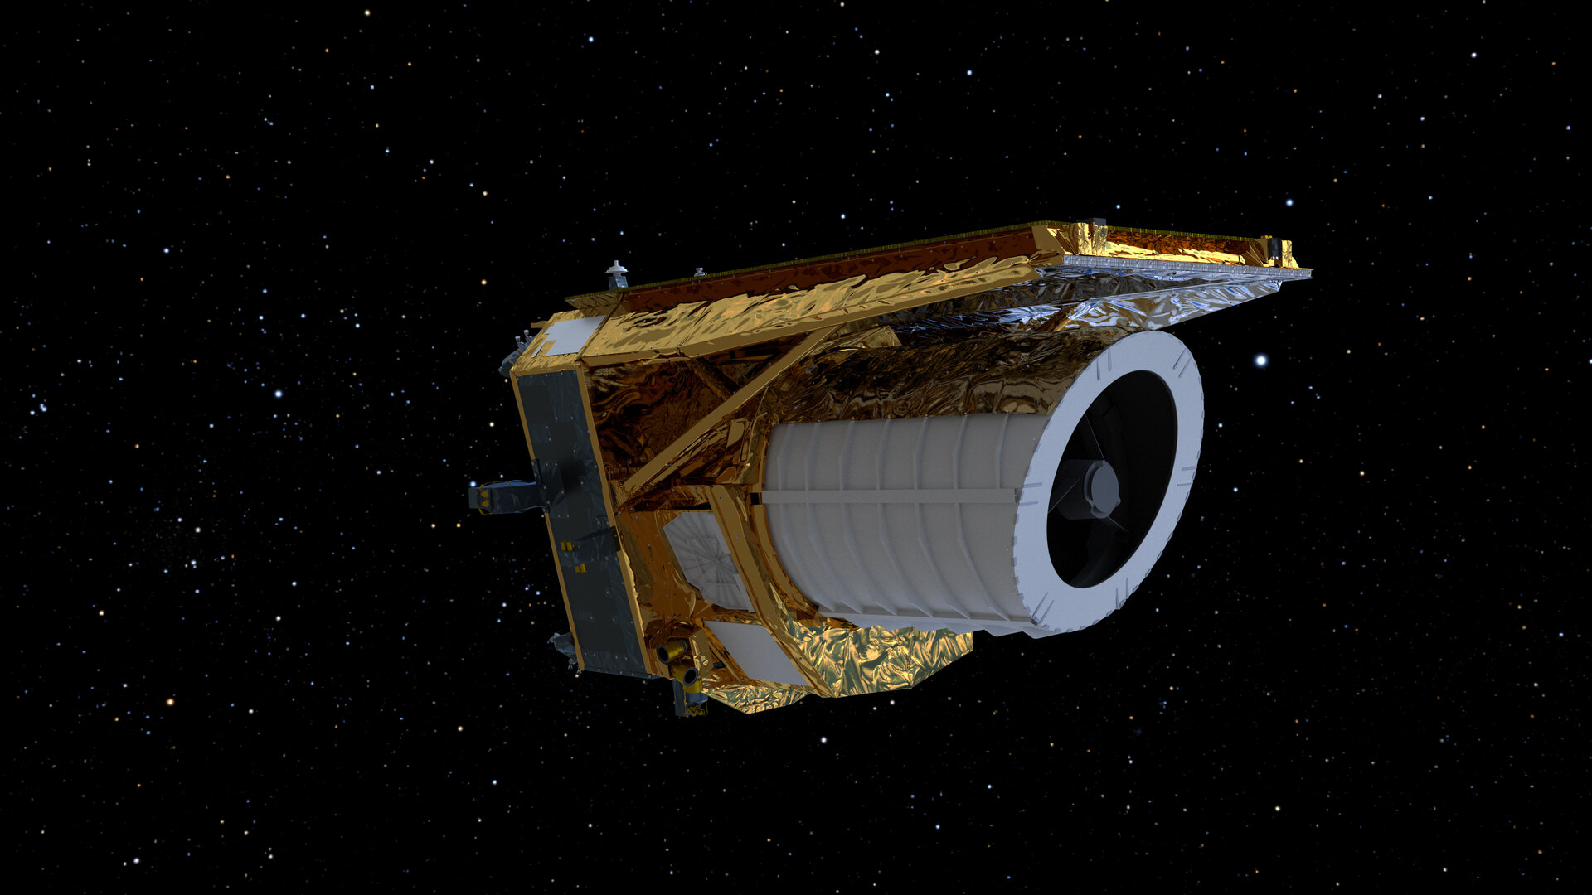
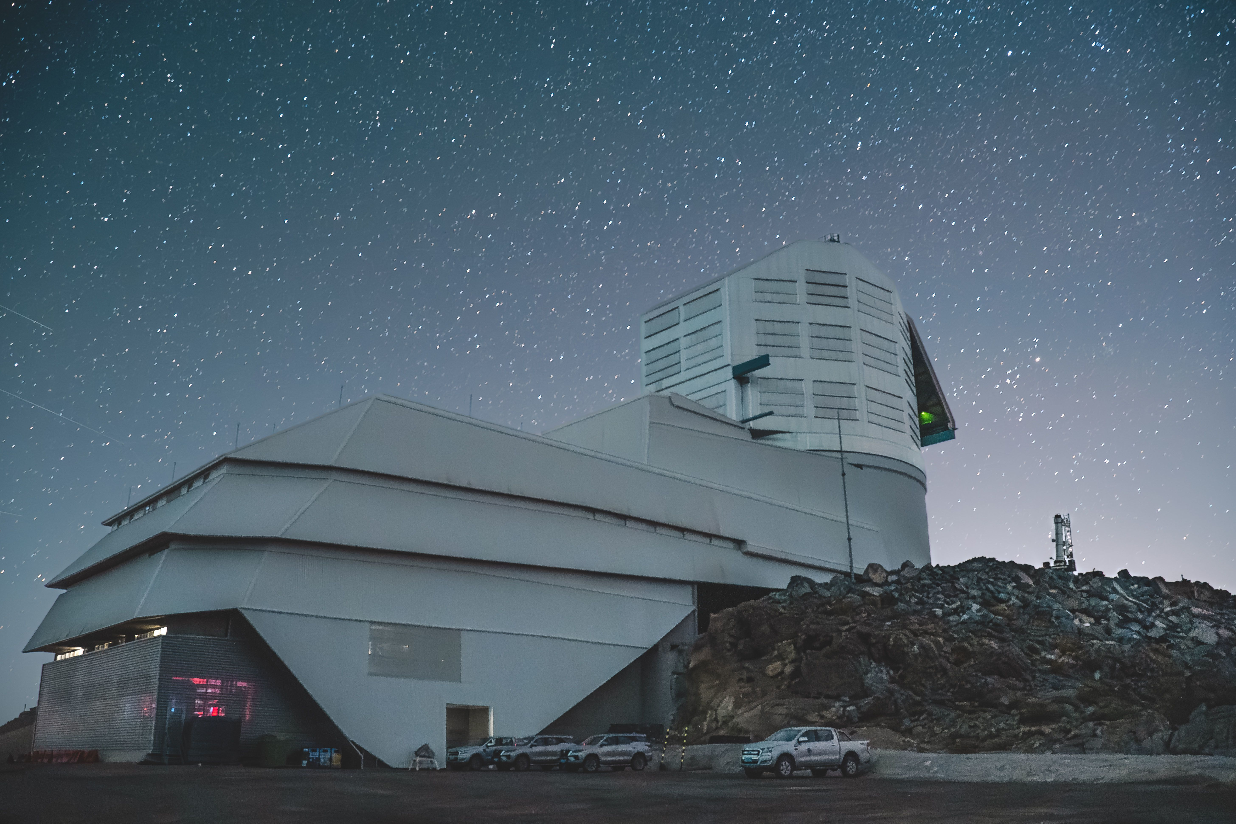
Why is this IMPORTANT?
Vera C Rubin Observatory expected to find > 1000 gravitational lenses
Euclid expected to find > 100,000 gravitational lenses
ESA/Euclid/Euclid Consortium/NASA, image processing by J.-C. Cuillandre, G. Anselmi, T. Li
Euclid & ESA
Aliro Pizarro Díaz/Rubin Observatory/NSF/AURA/

Slide 29
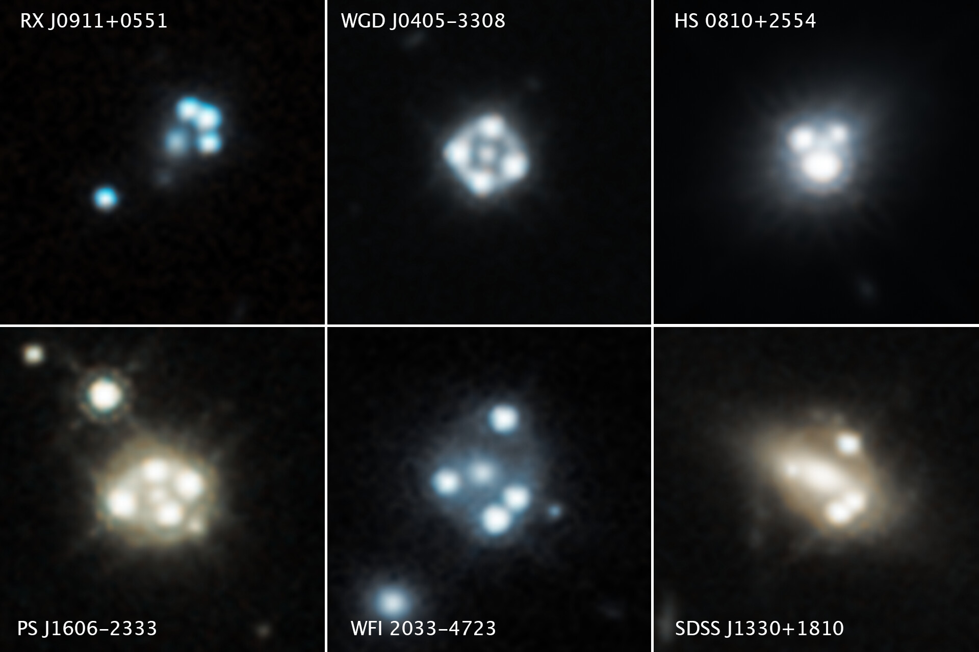
Conclusion
Investigate the accuracy of smooth mass models
Quantify the effect of shear on Model Anomalies
Future Work:
Unblind and compare our best smooth model with the actual mass profile
Add fourth order multipoles as a replacement for shear

Slide 30
References
[1] N. Arendse, E. M¨ortsell, L. Weisenbach, E. Hayes, S. Thorp, S. Dhawan, A. Goobar, S. Guerrini, J. O. Hjortlund, J. Johansson, and C. Lemon. Microlensing of lensed supernovae zwicky iptf16geu: constraints on the lens galaxy mass slope and dark compact object fraction, 2025. URL https://arxiv.org/abs/2501.01578.
[2] D. A. Torres-Ballesteros and L. Casta˜neda. ¡scp¿relensing¡/scp¿: Reconstructing the mass profile of galaxy clusters from gravitational lensing. Monthly Notices of the Royal Astronomical Society, 518(3):4494–4516, Nov. 2022. ISSN 1365-2966. doi:10.1093/mnras/stac3253. URL http://dx.doi.org/10.1093/mnras/stac3253.
[3] C Spingola, J P McKean, M W Auger, C D Fassnacht, L V E Koopmans, D J Lagattuta, S Vegetti, SHARP – V. Modelling gravitationally lensed radio arcs imaged with global VLBI observations, Monthly Notices of the Royal Astronomical Society, Volume 478, Issue 4, August 2018, Pages 4816–4829, https://doi.org/10.1093/mnras/sty1326

Slide 31
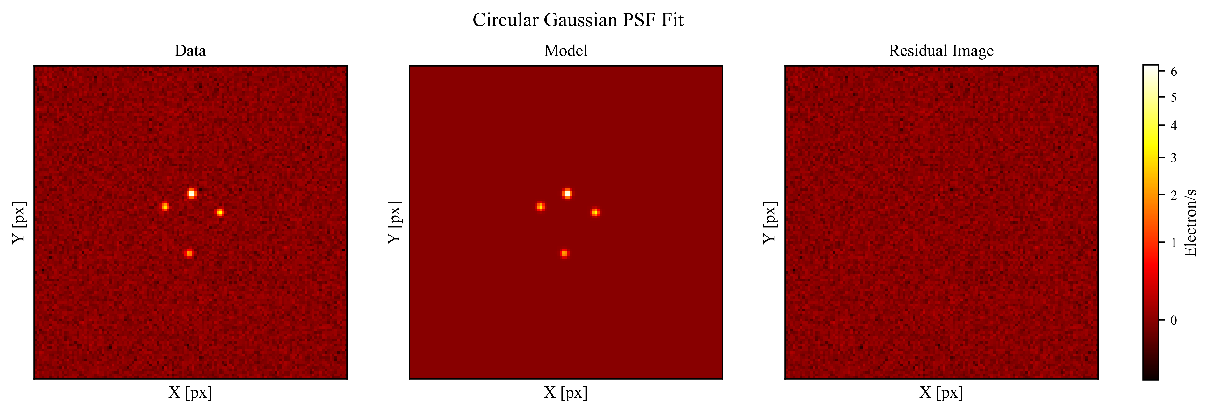
Data
Fit the each lensed image with a Circular Gaussian to get initial guesses for model parameters
Run an MCMC in Imfit using initial guesses

Slide 32
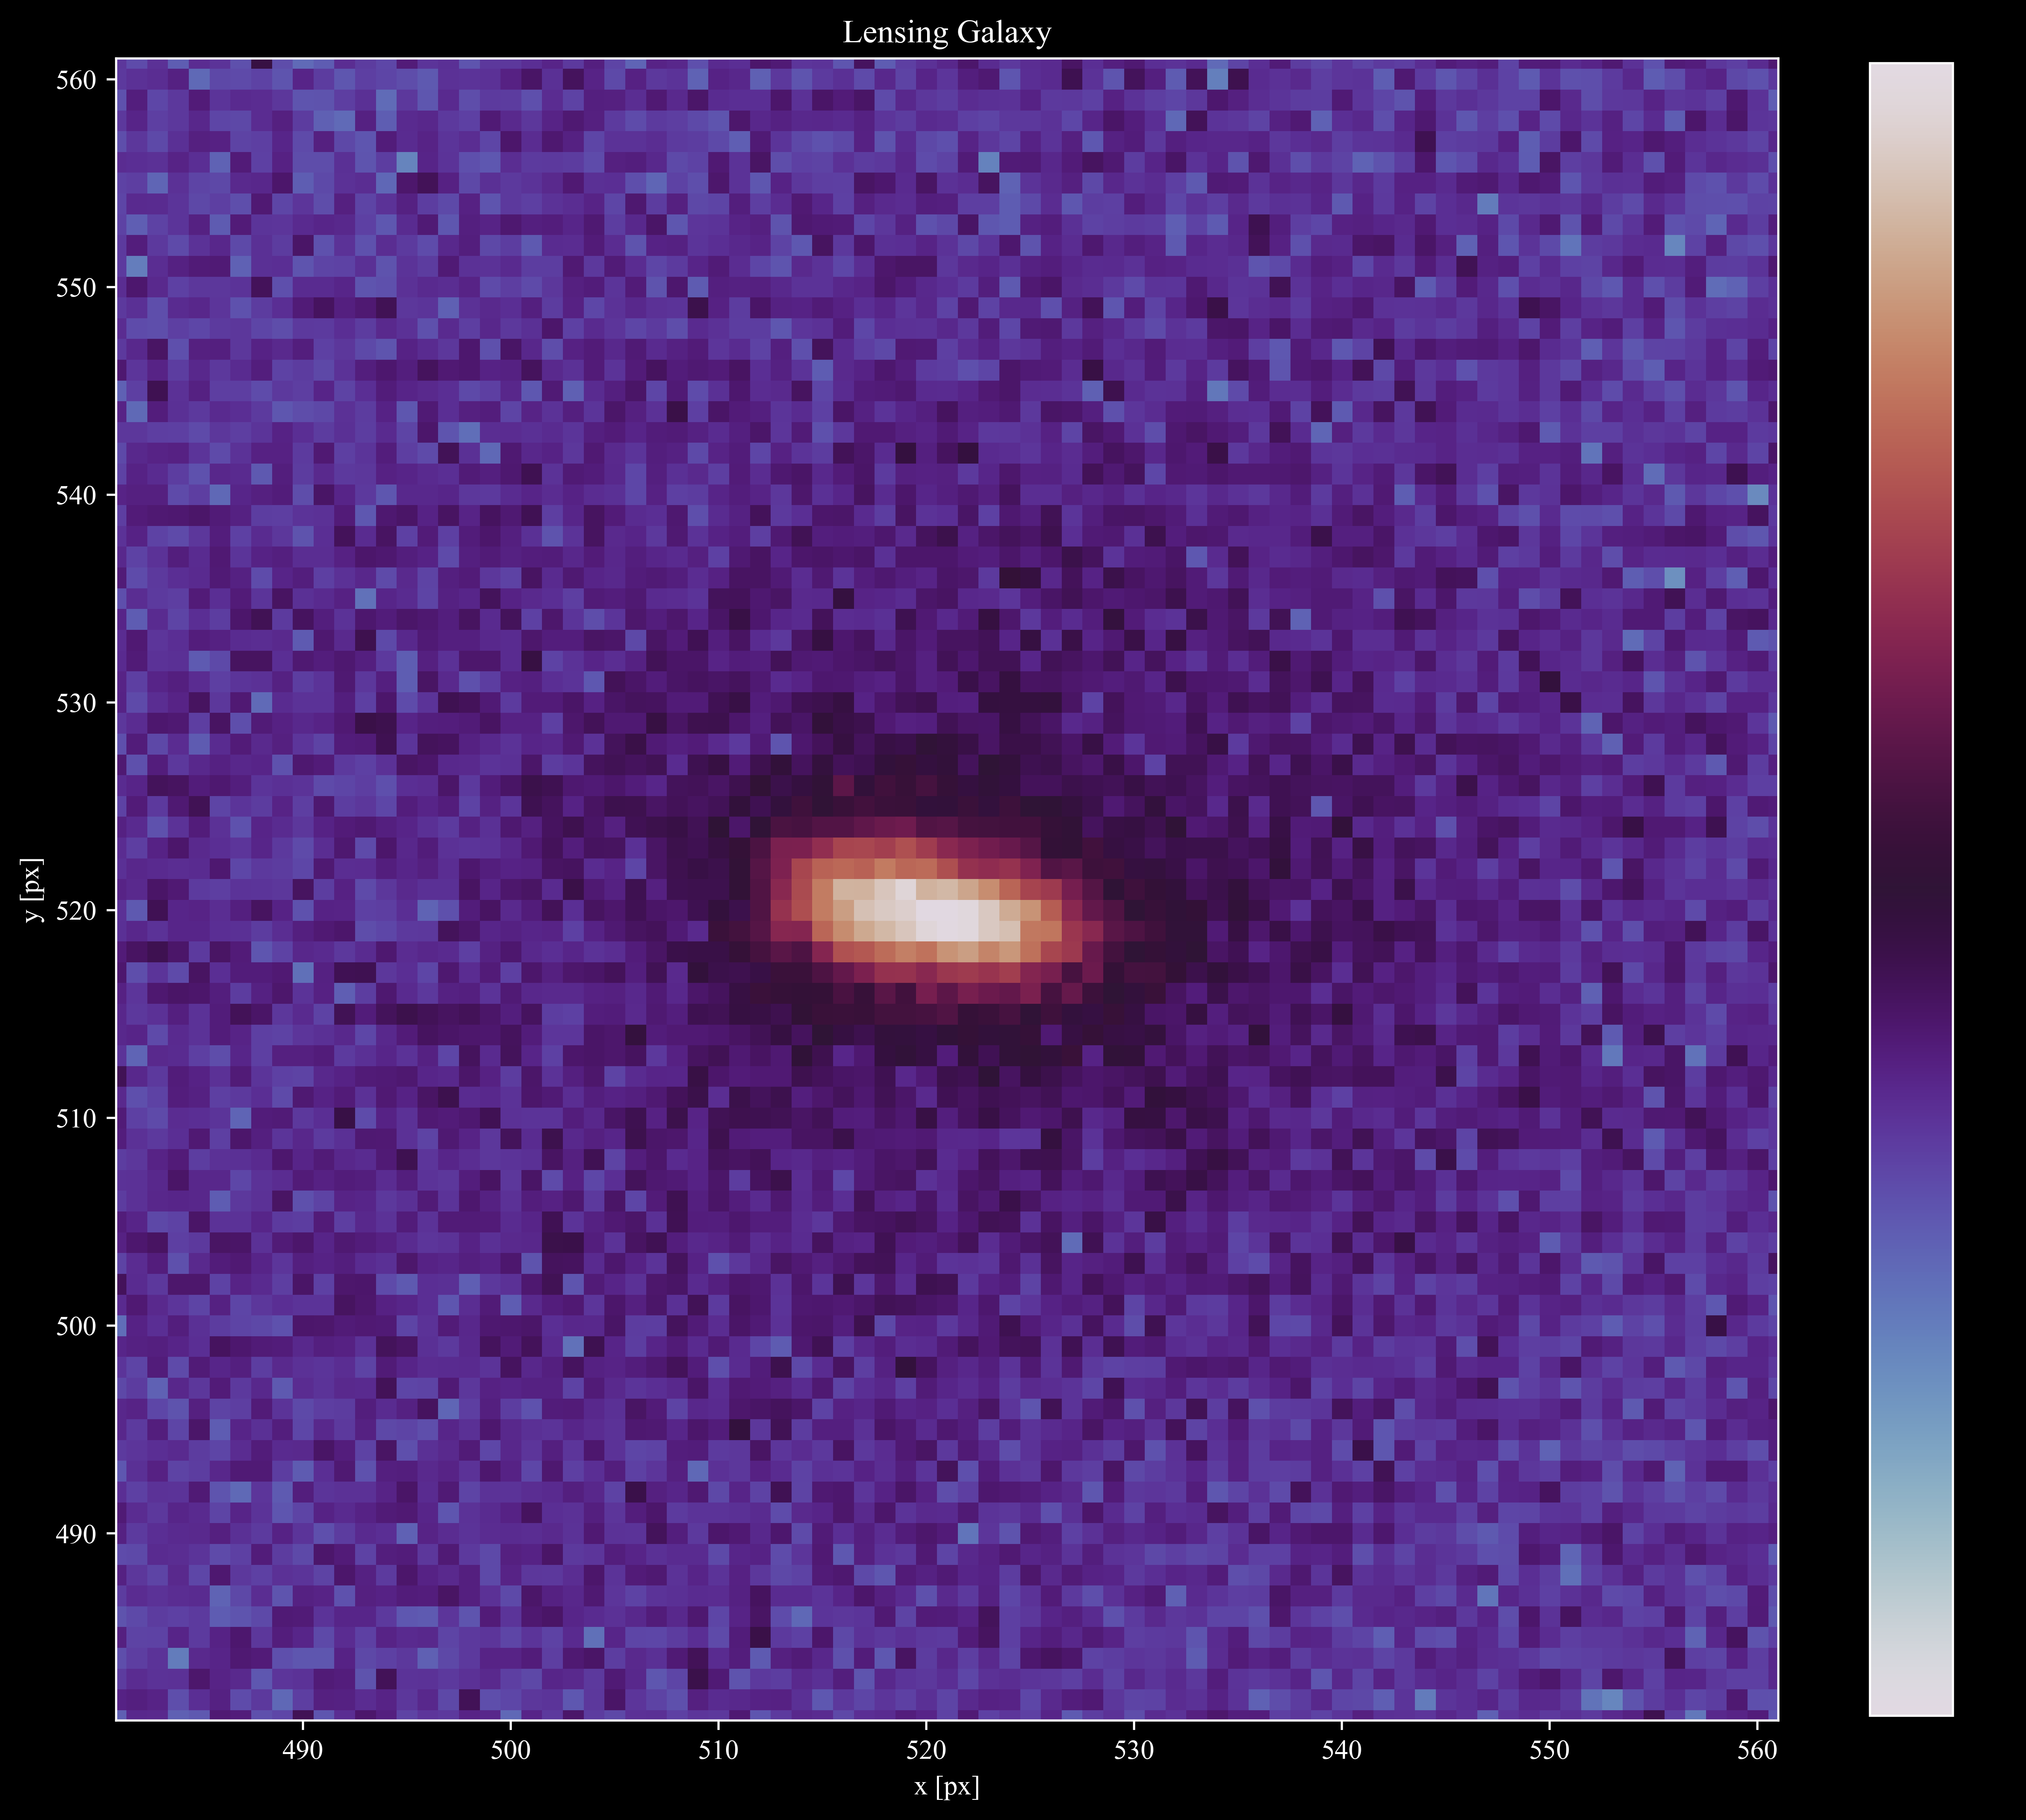
Data
Fit the light from the lensing galaxy (Post-SNIa observation) with a Sersic
Run an MCMC in Imfit

